Slide 1
CS4048 Data Science
Instructor: Dr. Kashif Zafar
January 27, 2026
Central Tendency
Lecture No. 2a

Slide 2
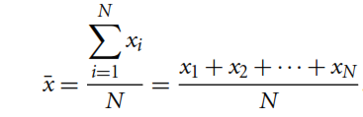

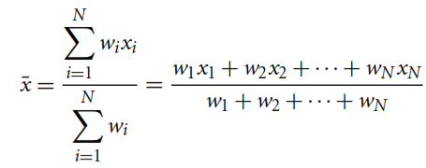

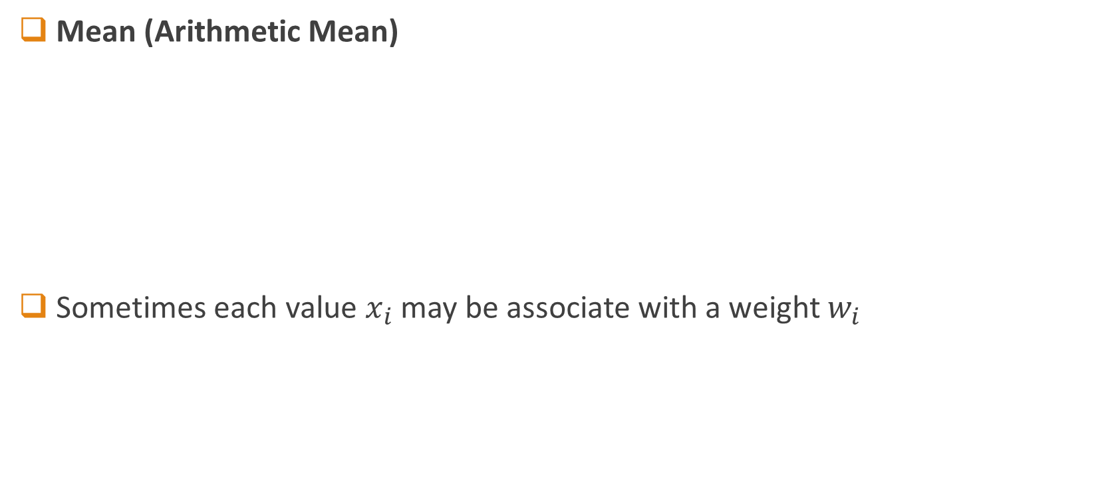
Measuring the Central Tendency
Mean (Arithmetic Mean)
Sometimes each value $x_{i}$ may be associate with a weight $w_{i}$
Mean is sensitive to extreme values!
Sometimes called $μ$
Weighted Arithmetic Mean (or Weighted Average)

Slide 3

Measuring the Central Tendency
Median
The middlemost value of the data (if number of data points are odd)
Average of two middlemost values of the data (if number of data points are even)

Slide 4
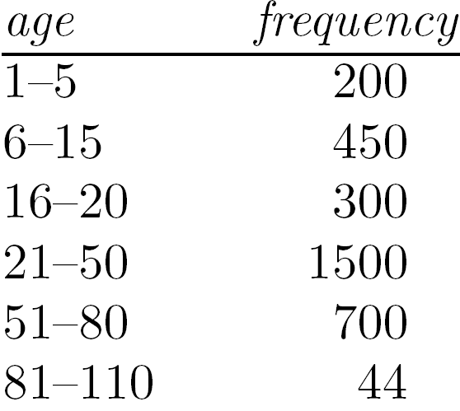
Measuring the Central Tendency
Median:
Good for skewed (asymmetric) data
Middle value if odd number of values, or average of the middle two values otherwise
Concept can be extended to ordinal data (odd – middle value even – median not unique)
Expensive when data is huge
Estimated by interpolation (for grouped data):
No. of values
Sum of frequencies of all the intervals that are lower than medial interval
Width of median range
Lower boundary of median range
Frequency of median interval

Slide 5
Median Estimation
age | Freq | Cum Freq
1-5 | 200 | 200
6-15 | 450 | 650
16-20 | 300 | 950
21-50 | 1500 | 2450
51-80 | 700 | 3150
81-110 | 44 | 3194

Slide 6
Measuring the Central Tendency
Mode
The most frequently occurring value of the data
Datasets with one, two, or three modes are called unimodal, bimodal, or trimodal respectively

Slide 7
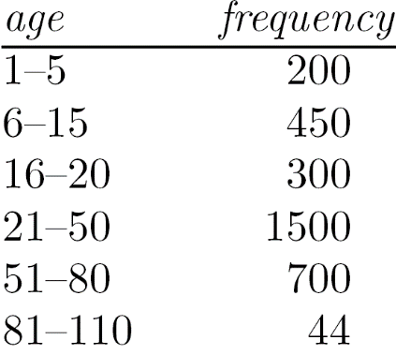
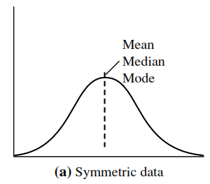
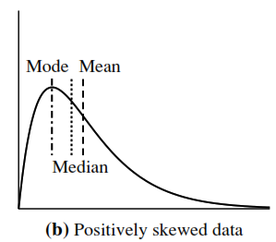
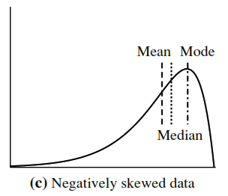
Symmetric VS Skewed Data

Slide 8
Five Number Summary of Dataset
Minimum Value
Lower Quartile (Q1)
Median (Q2)
Upper Quartile (Q3)
Maximum Value
How to compute 5-number summary?

Slide 9
Five Number Summary of Dataset
Sort the data, if not done already.
How to find median if the total number of data points is not odd?
Min
Q1
Median
Q3
Max
56
76
100

Slide 10
Five Number Summary of Dataset
Sort the data, if not done already.
Min
Q1
Median
Q3
Max
56
70
76
86
100

Slide 11
Five Number Summary of Dataset
Sort the data, if not done already.
Called Middle 50% (or IQR)
Any better way to represent this summary?
Lower Extreme
Min
Q1
Median
Q3
Max
56
Lower Quartile
70
Middle Quartile
76
Upper Quartile
86
Upper Extreme
100

Slide 12
MEASURE OF DISPERSION
Variance and Standard Deviation

Slide 13
Variance and Standard Deviation
Data Set 1: 3, 5, 7, 10, 10
Data Set 2: 7, 7, 7, 7, 7
Data Set 1: mean = 7, median = 7
Data Set 2: mean = 7, median = 7
But we know that the two data sets are not identical! The variance and standard deviation shows how they are different.

Slide 14
Variance and Standard Deviation
Both Indicate how spread out a data distribution is.
Square root of variance is called Standard Deviation
A low standard deviation means that data observations tend to be very close
A high standard deviation indicates that data observations are spread over a large range of values
Recall example of Mean we computed earlier…

Slide 15


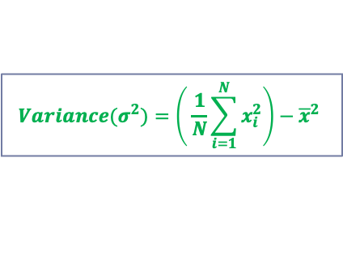
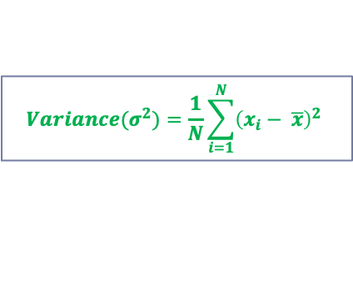
Variance and Standard Deviation
Variance
Standard Deviation
$${Variance(σ}^{2})=\frac{1}{N}\sum_{i=1}^{N}{{\left(x_{i}− \overline{x}\right)}^{2}}$$
$${Variance(σ}^{2})=\left( \frac{1}{N}\sum_{i=1}^{N}{x_{i}^{2}}\right)−{\overline{x}}^{2}$$
How many standard deviations away are these data points from mean?

Slide 16






Variance and Standard Deviation
One Standard Deviation
Two Standard Deviations
Three Standard Deviations
$$(μ±σ)$$
$$STD_{away}= \frac{x_{i}−\overline{x}\left(or μ\right)}{σ}$$
Z-Score
$$STD_{away}= \frac{70−58}{19.47}=0.62$$
$$(μ±2σ)$$
$$STD_{away}= \frac{30−58}{19.47}=−1.44$$
$$(μ±3σ)$$
How many standard deviations away are these data points from mean?

Slide 17
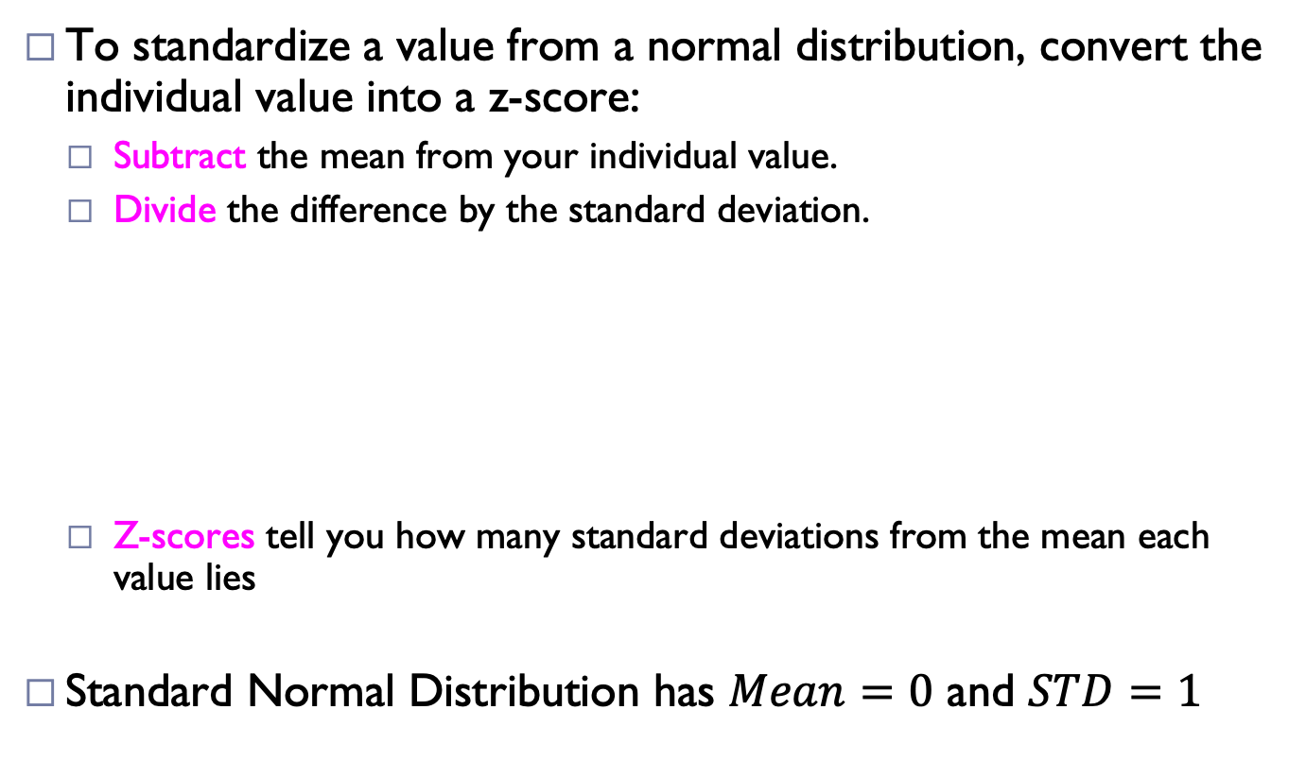


Z-Score: Standard Normal Distribution
To standardize a value from a normal distribution, convert the individual value into a z-score:
Subtract the mean from your individual value.
Divide the difference by the standard deviation.
Z-scores tell you how many standard deviations from the mean each value lies
Standard Normal Distribution has $Mean=0$ and $STD=1$
$$Z= \frac{x−μ}{σ}$$
$$Also called Z−score normalization$$
Working Example and Explanation: https://www.scribbr.com/statistics/standard-normal-distribution

Slide 18
Z-Score: Standard Normal Distribution
A positive z-score means that your x-value is greater than the mean.
A negative z-score means that your x-value is less than the mean.
A z-score of zero means that your x-value is equal to the mean.
Note: Relative Grading is done using Z-Score
Working Example and Explanation: https://www.scribbr.com/statistics/standard-normal-distribution

Slide 19
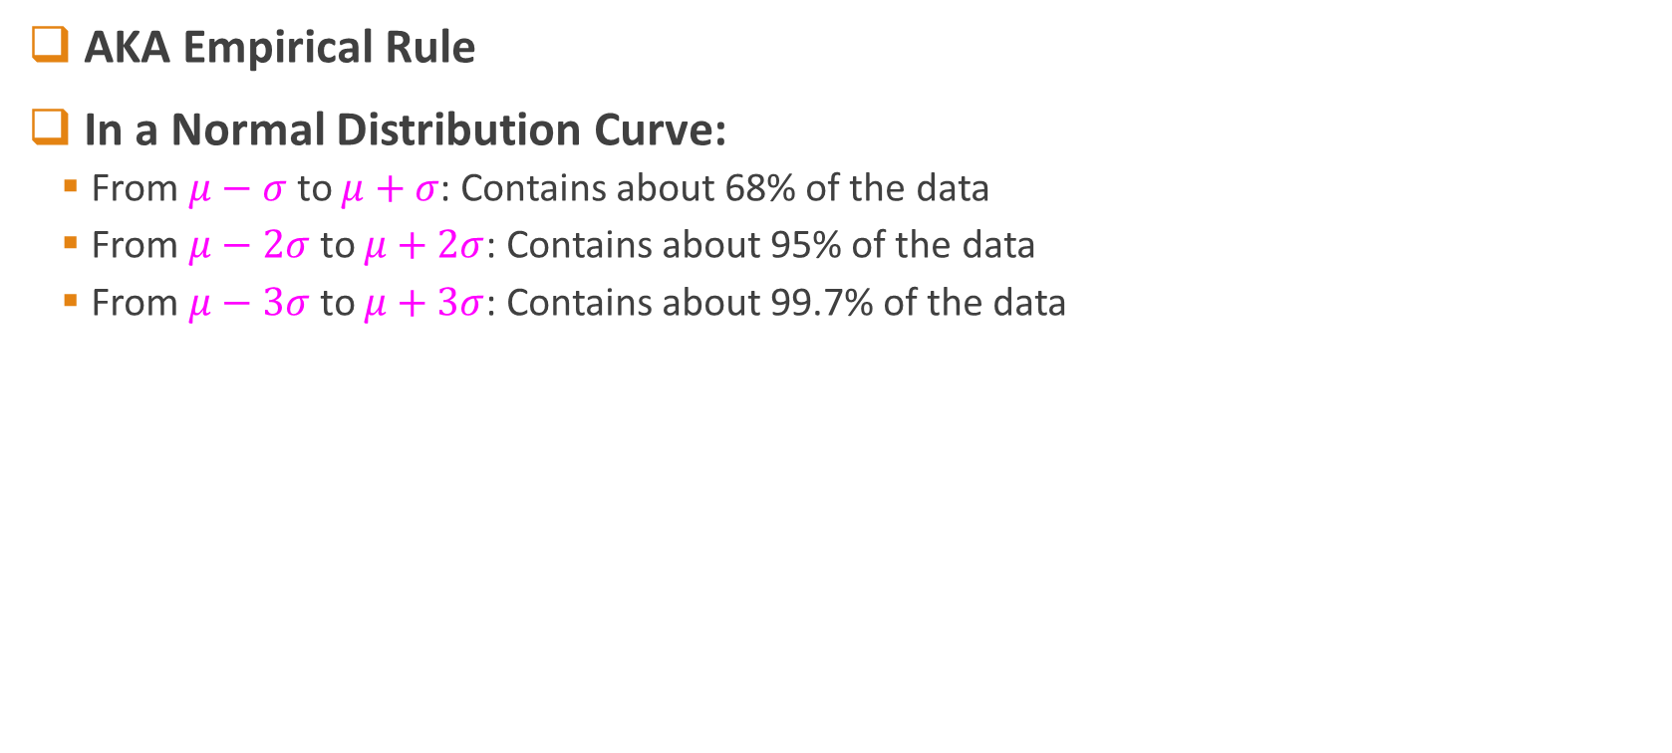
Properties of Normal Distribution Curve
AKA Empirical Rule
In a Normal Distribution Curve:
From $μ−σ$ to $μ+σ$: Contains about 68% of the data
From $μ−2σ$ to $μ+2σ$: Contains about 95% of the data
From $μ−3σ$ to $μ+3σ$: Contains about 99.7% of the data

Slide 20
Reading Homework
Chapter 2 (Han and Kamber)

